Slide 1
Enterprise Programming Project LEARNATHON [P-29] : University Event Management System
EP Section: S11
2S-EP-11-13
Team Members:-
2000030396 - Josyula Sri Siva Naga Sai Aiswarya (Team Lead)
2000030417 – Kadambari. Gayathri Phani Sri nitya
2000030619 – Medapati. Phani Sri Rama Lakshmi

Slide 2
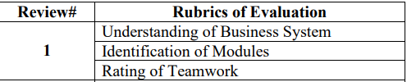
REVIEW-1 OBJECTIVES:

Slide 3
University Event Management System:-
The University Event Management system allows the administrator to store the details of events and the user details.
The implementation of this system will reduce the data entry, cost, time and also provides the readily calculated reports.
An university event management system [or] event management system can create and manage invitations, tickets and confirmations, event payments.
It can also maintain the overall event marketing and management including attendance check-in, attendee engagement and the creation of event landing pages.

Slide 4
Process of Planning for an Event Management :-
The process of planning for an university event (or) an event must be divided into 5C’s.
1. Concept:- This step describes the main concept and aim of our event.
2. Coordination:- One must have the team coordination, to get the work done fast and successfully.
3. Control:- One must control each and every aspect of the event.
4. Culmination:- One must attain the highest point.
5. Close Out:- In this step, one must ensure they complete the event successfully without any issues.

Slide 5
What is an university event management system:-
The university event management system project will work and update the event’s records, participant’s records, all type of expenditures during an event, staff and employee’s records.
In this university event management project, our main aim is to create a system where the students can register various events organized by Department, and the Administrator can generate the final winners and students will have a provision to download the certificate and generate the client profiles.
This system’s website will provides a computerized system that will benefit the student as well as the staff of the university.
It will also have a facility for staff members [or] faculty to login, and also can add and maintain the University Events.

Slide 6
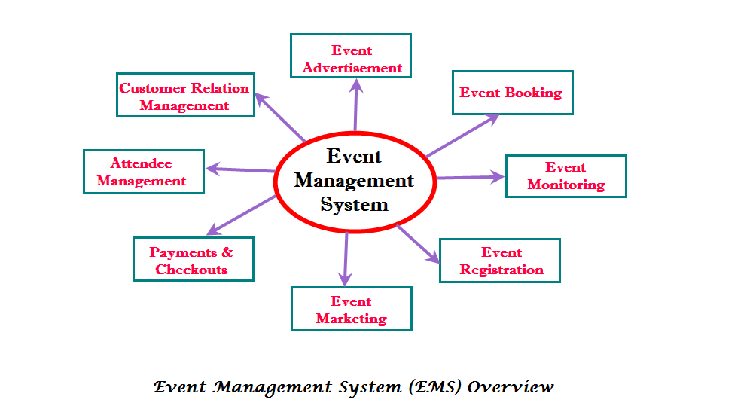
Diagram on the Event Management System:-

Slide 7
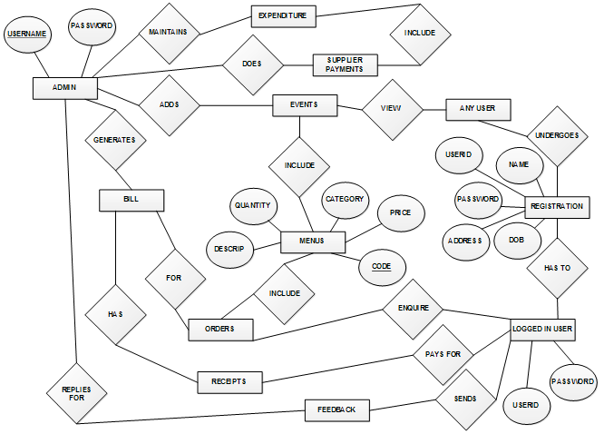
Entity-Relationship Diagram For University Event Management System:-

Slide 8
Requirements for our project design:-
Programming Language:- Java
Front-End Development:- JSP(Java Server Pages) & JSF(Java Server Faces).
Hardware Interface:- Windows 10/11
Tools:- Java EE-8 environment, Red hat Code Ready Studio, MySQl Workbench.
Database:- MySql
Running Server:- JBOSS Server with the configuration of -[Red Hat Jboss EAP 7.1]
Internet Browser:- Google Chrome/ Microsoft Edge.

Slide 9
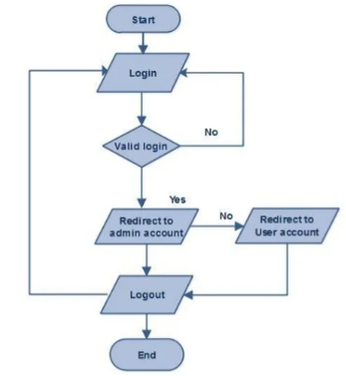
Flow Chart for University Event Management System:-

Slide 10
Modules Implementing in project:-
Admin Module:- This module will allow Admin to log in to the system and manage the system and its functions. Admin can View/Confirm/Cancel bookings, manage venues can check payments, etc.
User Module:- In this module, a user can register themselves first using their ID number,name, contact number, and address and also, can manage their profile. The user module will allow users to log in to the system using their ID number, names & contact number. Users can view their booked event, payment status, history, etc.
Booking Module:- In this module, Users can do the venue and other bookings. Users can mention all the requirements for the events in this module while booking.

Slide 11
Category:- In this module, Admin can categorize event plans, venues, etc accordingly.
Payment Module:- In this module, Users can make payments for the services provided.
Availability:- In this module, Admin can check whether the particular venue for the events is available or not.
Event Planner Module:- In this module, Admin can manage the event planner and its staff. Admin can allot event planners to the User who has done the booking for any events.
Venue Module:- This module will help the Admin list and manage all the venues for small and large gatherings available for the events. Venue location, size, etc can be updated by Admin in this module.

Slide 12
User Roles:-
Two users can interact with this application:-
1) Admin
2) User
Admin:-
Can Log in/Log out of the system.
Admin can manage categories in the system.
Admin can View/Confirm/Cancel booking orders placed by the User.
Can check payments done by User.
Can manage and check the availability of venues for the events.

Slide 13
Can manage the event staff.
Can change prices of packages for event plans, venues, catering services, etc.
Can change password.
Can manage “My Profiles”.
User:-
Can log in/log out of the system.
Can Manage “My profile”.
Can search for event packages available, venues, etc in categories.
Users can book/cancel a booking.
Can make payments online.
Can change password.

Slide 14
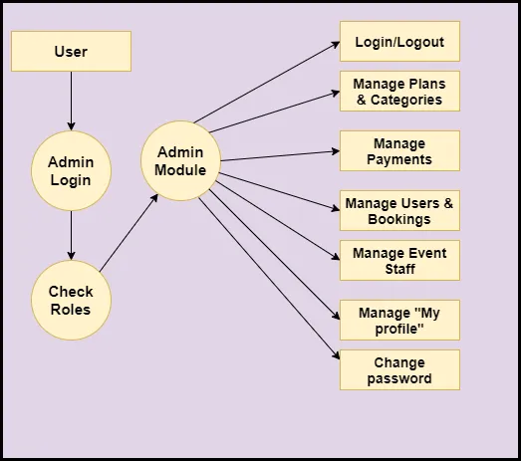
Flow Diagram for Admin Role:-

Slide 15
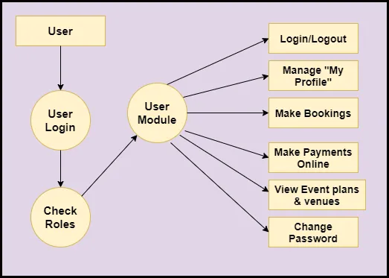
Flow Diagram for User Role:-

Slide 16
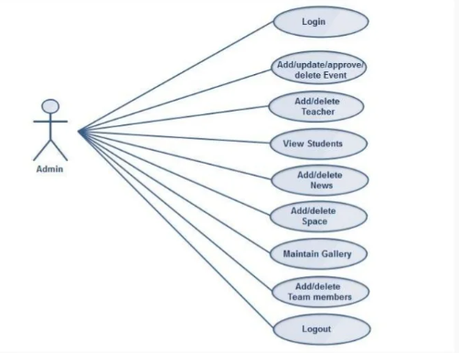
Admin Use Case:-

Slide 17
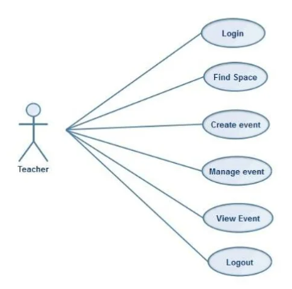
Staff/ Faculty Use Case:-

Slide 18
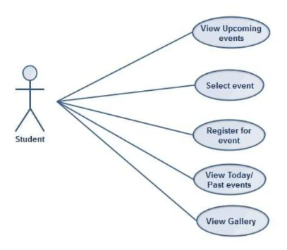
Student Use Case:-

Slide 19
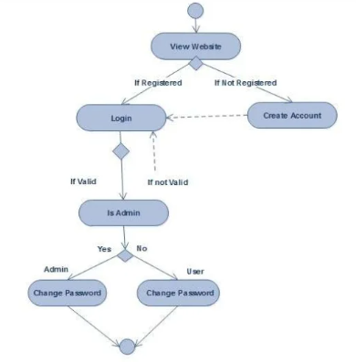
Activity Diagram of Login:-

Slide 20
Advantages & DisAdvantages of University Event Management System:-
Advantages:-
Overcomes the dependency of a single person handling all the activities.
Students could easily register for the event of their choice.
Multiple teacher can use the web interface to login and perform the desired task.
Easy results generation and view rankings.
Easy to access the system anywhere and anytime.
DisAdvantages:-
1. Requires an active internet connection.

Slide 21


